Slide 1
Emotion Detection Using Deep Learning
Danny Phan 301698774, Illya Gordyy 302682939
CSC 180
Final Project
11/25/2024
Table of Contents
Problem Statement
Methodology
Experimental Results and Analysis
Task Division and Project Reflection

Slide 2
1. Problem Statement
This project implements an NLP based neural network model in TensorFlow to detect emotions from text data. The goal is to classify text into six distinct emotion categories: anger, fear, joy, love, sadness, and surprise.
This problem will be modeled as a multiclass classification problem.
The dataset that will be used is the Hugging Face Emotion dataset, consisting of twitter messages which reflect diverse emotional expressions.
By the end of this project, the goal is to accurately classify tweets into their respective emotional categories based on their content.
As a result, we should be able to accurately determine the emotional tone of a given text, enabling applications such as sentiment analysis, user feedback evaluation, and mental health monitoring.

Slide 3
2. Methodology
To build an NLP-based multiclass classification model, the following steps were followed:
Prepare the Dataset
Load the Emotion Dataset from Hugging Face, which contains labeled tweets across six emotion categories.
Split the dataset into training, validation, and testing sets
2. Text Processing
Clean and process text by removing noise such as URLs, special characters, etc.
Apply Tokenization and building a vocabulary using the Tokenizer class
Word Embedding
Use GloVe pre-trained embeddings to create an embedding matrix that captures semantic relationships in the text data.
4. Model Design and Training
Design a Bidirectional LSTM-based neural network for capturing long-term dependencies in the text.
Add dense layers for classification into six emotion categories.

Slide 4
2. Methodology
5. Model Optimization
Use techniques like EarlyStopping and ModelCheckpoint to avoid overfitting.
Experiment with hyperparameter tuning, activation functions, optimizer types, and layer configurations.
6. Evaluation
Evaluate the model using metrics such as precision, recall, and F1-score
Generate confusion matrices for performance analysis.

Slide 5
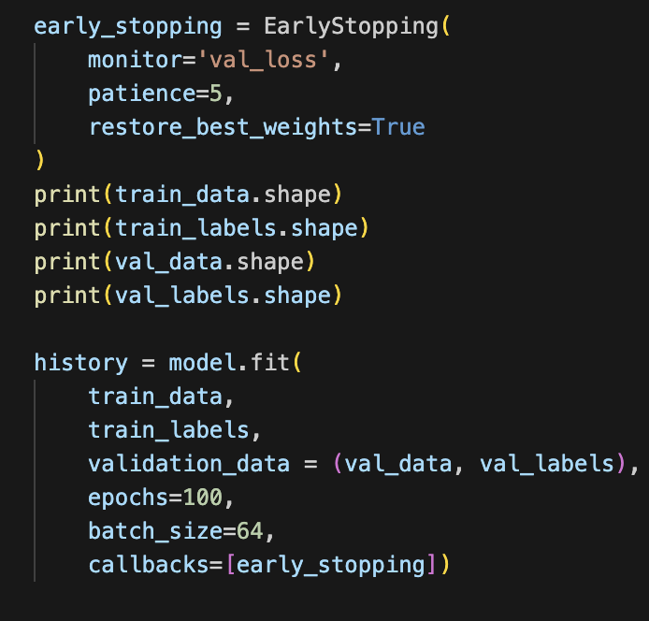
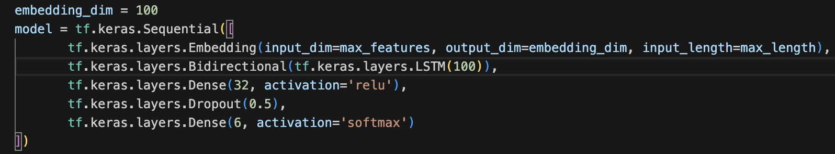
3. Experimental Results and Analysis
Results of the NLP model and NLP with GloVe
NLP
A Bidirectional LSTM-based model trained using tokenized text

Slide 6
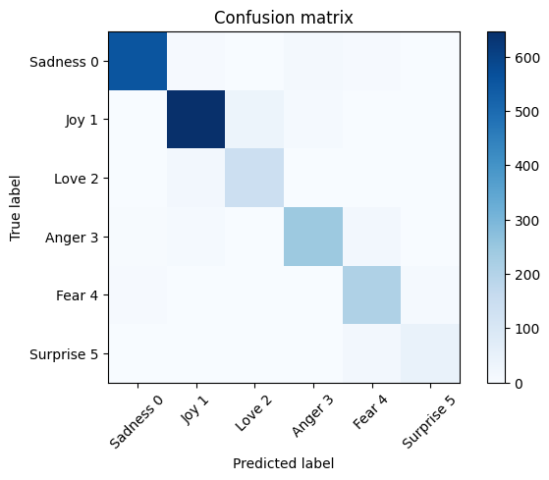
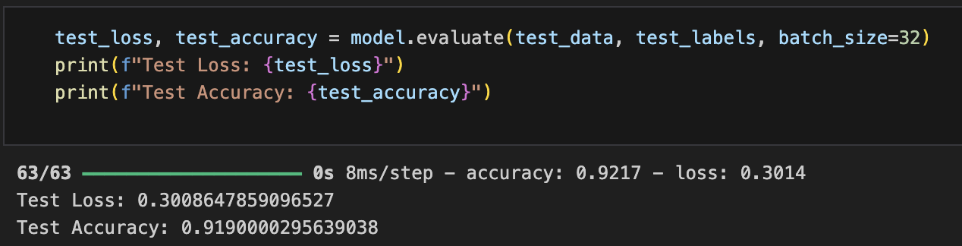
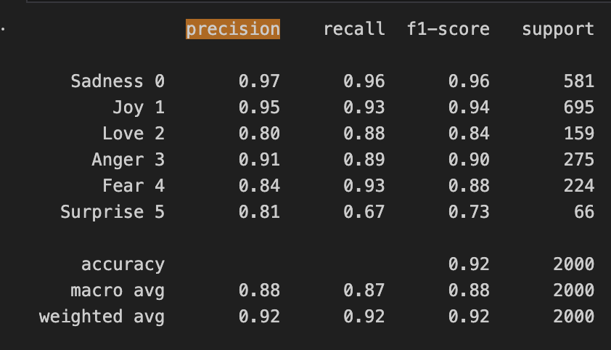
Result of NLP

Slide 7
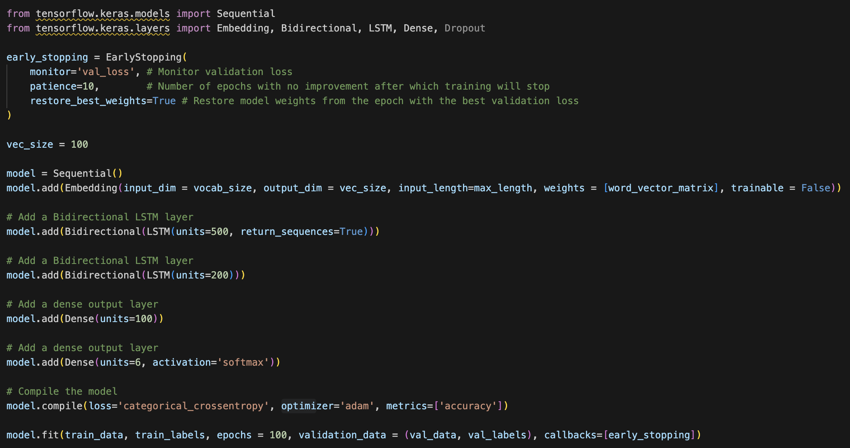
NLP with GloVe
Using Bidirectional LSTM

Slide 8

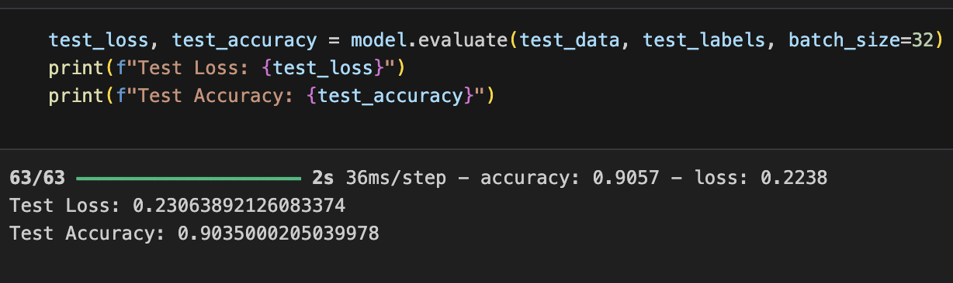
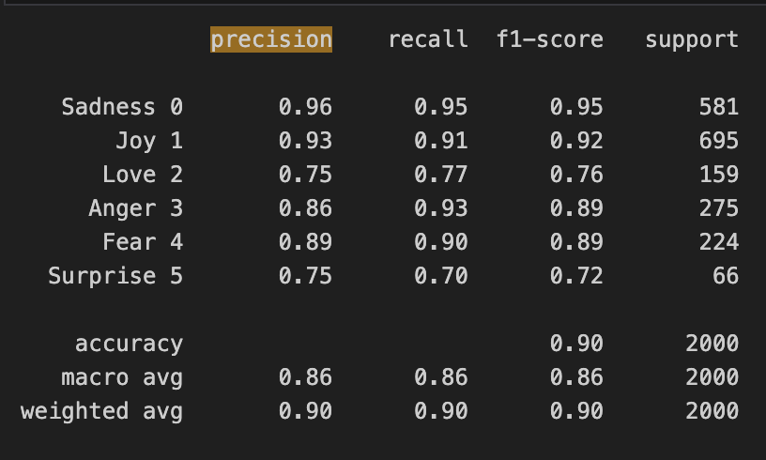
Result of NLP using GloVe

Slide 9
4 Task Division and Project Reflection
No. | Task | Assigned to
1 | Data collection and analysis | Danny and Illya
2 | Data Preprocessing and Feature Engineering | Danny and Illya
3 | NLP Model | Illya
4 | NLP w/ Transfer Learning | Danny and Illya
This project provided a deep dive into natural language processing (NLP) and the application of deep learning models to text classification. Applying Bidirectional LSTM helped improve the model’s ability to capture sequential patterns in text. Also, GloVe embeddings significantly improved model performance by capturing word semantics and contextual information, compared to simple tokenization approaches. Overall, this project strengthened our problem-solving and collaboration skills, as we navigated challenges together and leveraged each other’s expertise to successfully complete the project.

